Slide 1
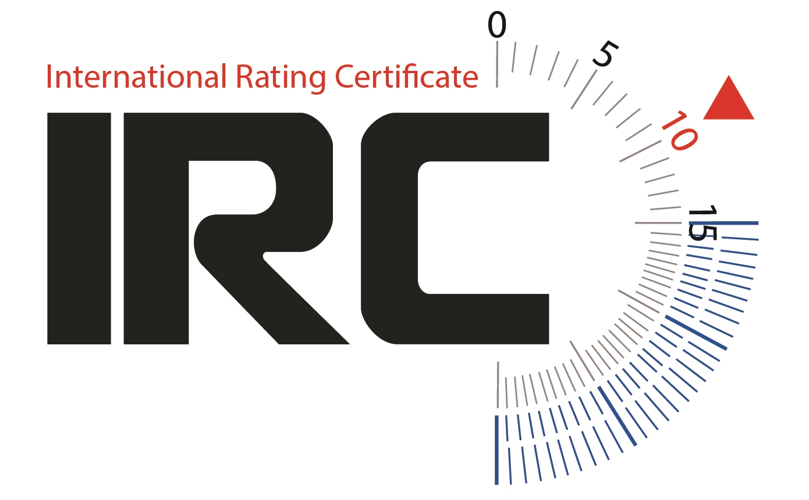
IRC and ERS Rule Changes Measurers Conference
7 & 8 March 2018

Slide 2
IRC Rule Changes 2017
2.6 Calculation of IRC
17.1 Boat Weight
17.5 Boat Weight from sailing weight
18.1 Overhangs and Draft
19.6 Hull Appendages – material in the fin
22.3.3 List angle
Definitions:
Series Date and Age Date
STL
Aft Rigging
HUW, MUW 7/8 Width of Headsail and Mainsail
Notes:
2.6 Calculation of IRC – Reasons for change:
Clarify that there is not subjective elements in IRC formulation now.
17.1 Boat Weight – Reasons for change:
To bring the rule in accordance with ERS.
17.5 Boat Weight from sailing weight – Reasons for change:
To bring the rule in accordance with ERS.
18.1 Overhangs and Draft – Reasons for change:
To bring the rule in accordance with ERS.
19.6 Hull Appendages – material in the fin:
Reason for change: With the introduction of the rating of bulb weight in IRC for keel types 10 to 12 over the past few years, and the addition of the bulb weight to the IRC certificate in 2016, the focus on the optimum approach to weight distribution within the keel for these keel types has become sharper.
It has become apparent that as ballast in the keel bulb is rated, but any ballast that is transferred to the lower section of the keel fin is not, there is an incentive for teams to accept a slight raising of the vertical centre of gravity for a reduction in rating that is greater than the performance reduction.
22.3.3 List angle – Reasons for change: Basically changes “static heel angle” to list angle to use ERS definition.
Definitions:
Series Date and Age Date – Reasons for change:
Delete the IRC definitions age Date and series date. Age date and series date are now defined in ERS.
STL – Reasons for change:
Currently if a boat is rated without a spinnaker then STL is set to zero. However, such boats generally use headsails hoisted to the masthead and flown from the end of the bowsprit. As such it seems appropriate that the STL is not ignored.
Aft Rigging – Focus on this, more in a moment
HUW, MUW 7/8 Width of Headsail and Mainsail – Reasons for change:
To bring the definition in accordance with ERS.

Slide 3
Aft Rigging
Aft rigging: The total number of stays and/or sets of stays connected to the mast spar above the top of the boom set horizontal providing aft support and/or control.
(a) Any pairs of stays attached to the mast spar at the same position port and starboard on the mast spar shall count as one set of stays. Eg, whether there be a single standing backstay or twin running backstays these are counted as one set of stays.
(b) Any deflectors or adjusters attached between the top most stay and the mast spar shall also be counted. Any deflectors or adjusters attached between any other stay and the mast spar with separation from the attachment point of the primary stay of 10% of P or greater shall also be considered as a separate stay for these purposes.
Notes:
Over recent years it has become apparent that many of the arrangements available to offshore boats as far as aft rigging attachments is concerned are not completely covered by the ERS definitions.
Modern materials are allowing spar manufacturers and riggers a far wider range of options than previously. It is also recognised that the principal purpose of rating various options is to determine the number of points on the mast spar where adjustment is possible. It has become increasingly apparent that the generally used definitions for different types of aft rigging (backstays, running backstays, checkstays etc.) do not suit all types of rigging arrangements.
It is therefore suggested that a simplified option is more appropriate:
From 2017 IRC will therefore use the following definitions for aft rigging:

Slide 4
Aft Rigging

Slide 5
Aft Rigging

Slide 6
Aft Rigging

Slide 7
IRC Rule Changes 2018
8.2.1 Short Handed Certificate
13.2 Measurements and Compliance
17.1 Boat Weight – berth cushions
21.5 Mainsails MUW, MTW and MHW
22.2.1 Hull Factor Evaluation
23.1 Seaworthiness and Safety (deletion of dayboat)
26.1 Advertising not permitted
Definitions:
Lifting Foils
Headsail Head Point Definition
Notes:
8.2.1 Short Handed Certificate – Reasons for change:
Rule 8.2.1 is unclear about which certificate a boat may use for a short-handed race. The intention is that if a boat holds a short-handed certificate, that certificate must be used for short-handed races. The boat cannot choose to use its primary certificate.
13.2 Measurement and Compliance – Reason for change:
The new ERS H.5.4 gives IRC the right to specify the blue batten specification to be used for extending a locally curved or irregular sail edge to find a corner point. IRC rates boats from 5.00m to over 30.00m LH, and the standard 1 metre WS Blue Batten is not appropriate for measuring very large sails.
17.1 Boat Weight – Berth cushions - Reason for change:
Rule 17.1 does not clearly allow for cushions to be removed for racing, and that therefore they should also be removed for measuring Boat Weight.
21.5 Mainsails – Reasons for change:
The default mainsail widths in Rule 21.5 are based on IOR defaults, which are now historic and no longer used by sailmakers. In addition, for accurate rating calculation the actual data should be used. Default widths were removed some years ago from Rule 21.7 (headsails) so it is inconsistent to state them for mainsails. It is suggested that that Rule 21.5 is simplified.
22.2.1 Hull Factor Evaluation – Reasons for change:
Rule 22.2.1 includes the phrase ‘..an assessment by the Rating Authority…’. This is not representative of current actual practice, as the Rating Authority uses objective methods for the calculation of HF.
23.1 Seaworthiness and Safety (deletion of dayboat) – Reason for change:
IRC Rule 24 addresses Dayboats, noting that they have ‘Dayboat’ printed on their certificates. The IRC definition of Dayboat is currently: “A Dayboat is defined as a boat with LH less than or equal to 10m which cannot meet any of OSR Categories 0 to 4." This may suggest to event Organising Authorities that a boat without ‘Dayboat’ on their IRC certificate complies with OSRs. The Rating Authority is not in a position to judge OSR compliance, so this is potentially misleading.
It is also inappropriate that IRC should specify safety equipment, as in IRC Rule 24. That is a matter for an Organising Authority.
From an IRC rating perspective, it is only relevant whether a boat is fitted with OSR compliant lifelines. Printing ‘Dayboat’ on a certificate is simply labelling a boat and serves no further purpose.
It is therefore proposed to amend IRC Rules deleting all references to ‘Dayboat’ and to clarify that issue of an IRC certificate is entirely independent of compliance with OSRs.
26.1 Advertising not permitted
IRC 25.1 refers to an incorrect Rule number. In addition, IRC Rule 26.1 refers to World Sailing Regulation 20.7. However, Regulation 20.7 does not relate to Competitors’ advertising so it cannot be referred to as such in the IRC Rule.
Definitions: Lifting Foils – Reasons for change:
To provide measurement inputs for the rating of horizontal foils eg. Dynamic Stability System (DSS), ‘Dali’ foils.
More next!
Definitions: Headsail Head Point Definition – Reasons for change:
The ERS 2017-2020 has amended the definition of headsail head point to what we use in our definitions (ERS g.4.2(b)). We should therefore delete it from IRC Definitions.

Slide 8
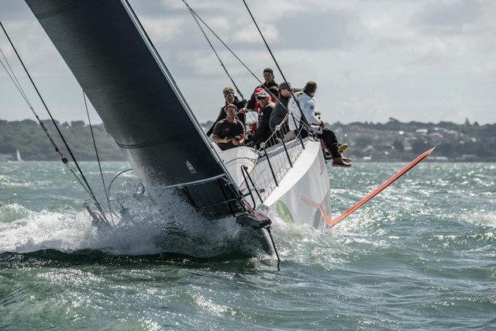
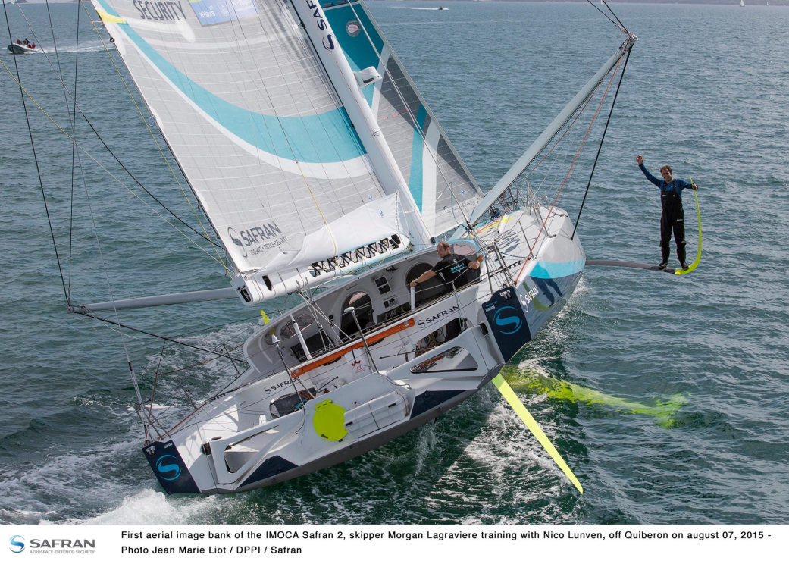
Foils

Slide 9
Foil Measurement
LIFTING FOILS:
No. of Foils: The maximum number of foils that may be actively in use simultaneously.
With the boat upright in flotation trim, for each foil:
Foil Span - The maximum transverse distance outside the hull shell between any two points on the foil in its fully extended position.
Foil Chord - The maximum longitudinal distance of the foil.
The IRC Rating Authority reserves the right to require additional detail to be supplied and also to modify the above definitions on a case by case basis in accordance with IRC Rule 2.8.
Notes:
To provide measurement inputs for the rating of horizontal foils eg. Dynamic Stability System (DSS), ‘Dali’ foils.
Note that the Rating Authority has the right to require additional information on the foil and the definitions can be modified in accordance with rule 2.8.

Slide 10
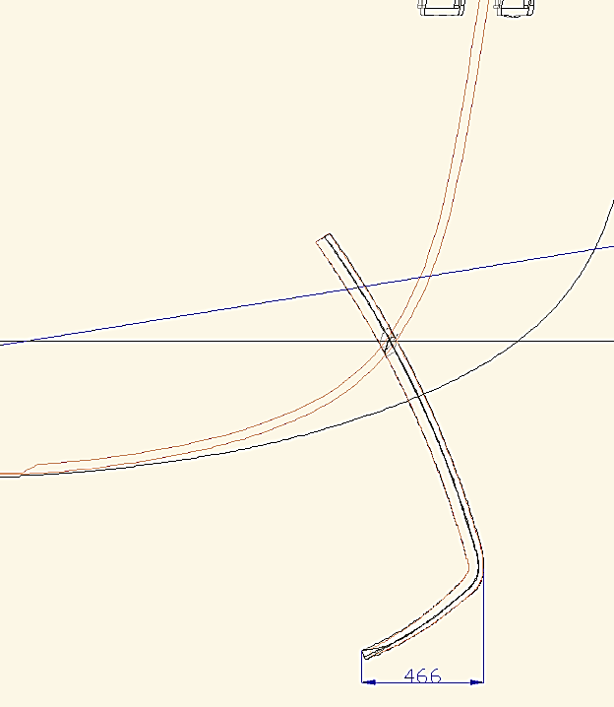
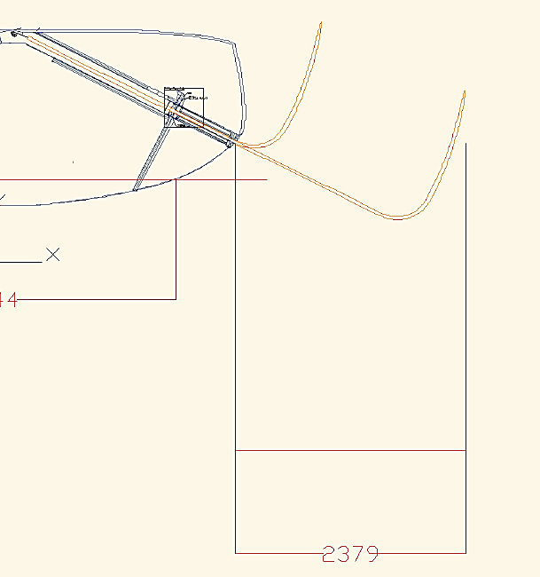
Foil Measurement

Slide 11
ERS Changes 2017-2020
ERS Updated for 2017-2020 version
Available using the World Sailing 2017-2020 App for iOS and Android - search for “World Sailing”
ERS Changes that affect IRC only
Notes:
The ERS has been updated for 2017-2020 version
Don’t forget the ERS and other World Sailing rules and regulations (for example Offshore Special Regulations) are available free from the App. Search for World Sailing in your iOS or Android App store.

Slide 12
ERS Changes 2017-2020
ERS C.6.3(c) - FLOTATION TRIM - IRC 18.1
ERS C.6.3(d) - WATERLINE - IRC DEFINITION
Notes:
1. Flotation trim - definition added as part of the ERS H.7.1 conditions for weight and flotation measurement
2. Waterline definition - removes the reference to class rules and only refers to the boat in measurement trim
3. Conditions for weight and flotation measurement – Conditions for Weight Measurement has changed to Conditions for Weight and Flotation Measurement that specifies the items to be included in the condition (e.g. rig, sheets, engines, permanent fixtures) and excluded (e.g. sails, fuel, variable ballast, safety equipment).

Slide 13
ERS Changes 2017-2020
ERS C.6.3(f)(iv) - VARIABLE BALLAST - IRC 8.2.1
ERS C.6.4(h) - BOAT WEIGHT – IRC 17
Notes:
1. Variable Ballast – definition changed to add water ballast which may also be moved (as well as varied).
2. Boat Weight – definition changed to exclude sails and variable ballast.
3. List Angle – definition added to ERS that is in accordance with IRC.

Slide 14
ERS Changes 2017-2020
ERS C.6.4(j) - LIST ANGLE – IRC 22.3.3
Notes:
1. Variable Ballast – definition changed to add water ballast which may also be moved (as well as varied).
2. Boat Weight – definition changed to exclude sails and variable ballast.
3. List Angle – definition added to ERS that is in accordance with IRC.

Slide 15
ERS Changes 2017-2020
ERS F.1.7(a) - STANDING RIGGING…
ERS F.1.7(a)(i) - SHROUD – IRC 21.1.6(a)(i)
Notes:
Standing Rigging – definition not used in IRC but forms part of shroud definition. “It may be adjustable but is not detached when racing except as below”
Shroud – sub-definition of standing rigging. Removal of “is not detached while racing” as that is part of standing rigging definition.

Slide 16
ERS Changes 2017-2020
ERS G.7.7 - Seven-Eighths Width - IRC DEFINITIONS
Notes:
Seven-Eighths Width – New definition added in ERS. Used directly in IRC.
Appendix 2 has been added to include the common abbreviations used for primary sail dimensions.

Slide 17
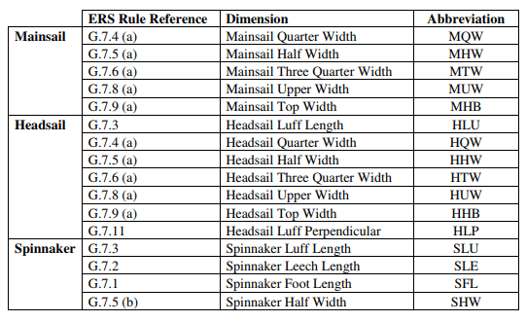
ERS Changes 2017-2020
APPENDIX 2 - Abbreviations for primary sail dimensions
Notes:
Seven-Eighths Width – New definition added in ERS. Used directly in IRC.
Appendix 2 has been added to include the common abbreviations used for primary sail dimensions.

Slide 18
ERS Changes 2017-2020
NOT USED! - ERS H.7.1 - CONDITIONS FOR WEIGHT AND FLOTATION MEASUREMENT - IRC 17.1
NOT USED! - ERS C.6.5(a) - SERIES DATE
NOT USED! - ERS C.6.5(b) - AGE DATE
NOT USED! - ERS E.1.2(m) - FOIL
Notes:
Series Date & Age Date - have been added but definition is not in accordance with IRC use, so therefore IRC definition now in rule.
Foil – definition has been added but not suitable for IRC as does not include a “hull foil”. Therefore new IRC definition has been added. More later.

